Slide 1
Testing
Mehwish Mumtaz

Slide 2
Software Faults and Failures Why Does Software Fail?
Wrong requirement: not what the customer wants
Missing requirement
Requirement impossible to implement
Faulty design
Faulty code
Improperly implemented design

Slide 3

Objective of Testing
Objective of testing: discover faults
A test is successful only when a fault is discovered
Fault identification is the process of determining what fault caused the failure
Fault correction is the process of making changes to the system so that the faults are removed

Slide 4
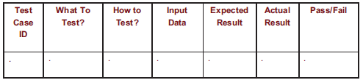
Elements of a Test Case
Purpose
Input
Expected Output
Actual Output
Sample Format:

Slide 5
Types of Faults
Algorithmic fault: e.g:functionality of a search engine
Computation and precision fault
a formula’s implementation is wrong: example round off error
Documentation fault
Documentation doesn’t match what program does
Capacity or boundary faults
System’s performance not acceptable when certain limits are reached.
Performance faults
System does not perform at the speed prescribed

Slide 6
Different Level of Failure Severity
Catastrophic: causes death or system loss e.g radiation machine
Critical: causes severe injury or major system damage:example reactors,airplane
Marginal: causes minor injury or minor system damage
Minor: causes no injury or system damage

Slide 7
Testing Issues Who Performs the Test?
Independent test team
avoid conflict
personal responsibility vs need to discover faults
allow testing and coding concurrently

Slide 8
Testing Types
The Black Box Test is a test that only considers the external behavior of the system; the internal workings of the software is not taken into account.
White Box Test is a method used to test a software taking into consideration its internal functioning. It is carried out by testers.

Slide 9
Test Cases for Triangle Problem
Test cases based on equivalence classes within valid range
TC Id | What to test | A | B | C | EO
1 | EC 1 | 15 | 15 | 15 | Equilateral
2 | EC 2 | 10 | 20 | 10 | Isosceles
3 | EC 3 | 5 | 6 | 7 | Scalene
4 | EC 4 | 1 | 2 | 10 | Not a triangle
Test cases based on input range
TC Id | What to test | A | B | C | EO
1 | EC1 of A | -10 | 15 | 15 | Value of A not in valid range
2 | EC1 of B | 15 | -10 | 15 | Value of B not in valid range
3 | EC1 of C | 15 | 15 | -10 | Value of C not in valid range
4 | EC3 of A | -205 | 15 | 15 | Value of A not in valid range
5 | EC3 of B | 15 | -205 | 15 | Value of B not in valid range
6 | EC3 of C | 15 | 15 | -205 | Value of C not in valid range
7 | EC2 of A, B, C | 15 | 15 | 15 | Equilateral

Slide 10
Whitebox Testing Control Flow Graph
Edges and Nodes Method
Cyclomatic Complexity = E – N + 2 = 9 – 9 + 2 = 2
Branch Method(Ifs,for,while)
C=B+1=1+1=2

Slide 11
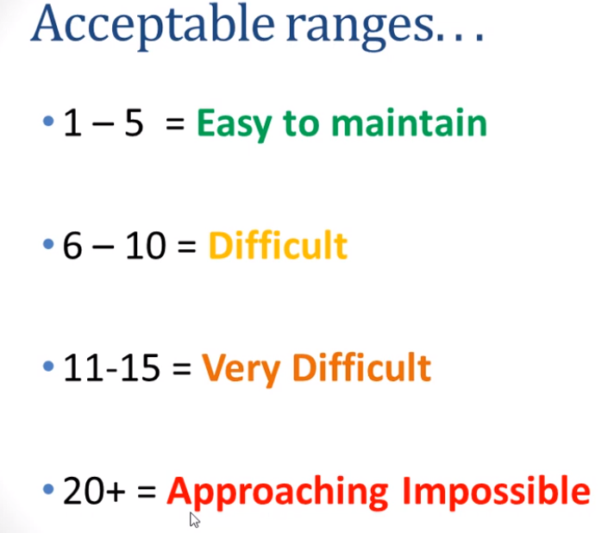
Whitebox Testing Control Flow Graph

Slide 12
Levels of Testing
Module testing, component testing, or unit testing
Integration testing
System Testing
Function testing
Performance testing
Acceptance testing
Installation testing

Slide 13
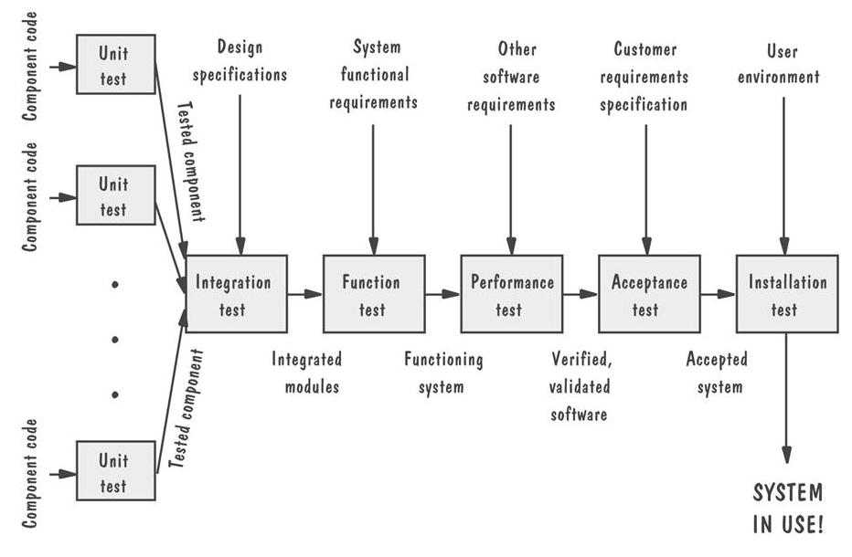
Levels of Testing Testing Organization Illustrated

Slide 14
Unit Testing Code Review
Code walkthrough(Informal)
Code inspection(Formal)

Slide 15
Unit Testing
Testing the unit for correct functionality
Testing the unit for correct execution

Slide 16
Unit Testing Steps in Testing
Determining test objectives
Selecting test cases
Executing test cases

Slide 17
Unit Testing
Statement testing
In this the test case is executed in such a way that every statement of the code is executed at least once
Branch testing
Test coverage criteria requires enough test cases such that each condition in a decision takes on all possible outcomes at least once, and each point of entry to a program or subroutine is invoked at least once. That is, every branch (decision) taken each way, true and false. It helps in validating all the branches in the code making sure that no branch leads to abnormal behavior of the application.
Path testing
In this the test case is executed in such a way that every path is executed at least once.

Slide 18
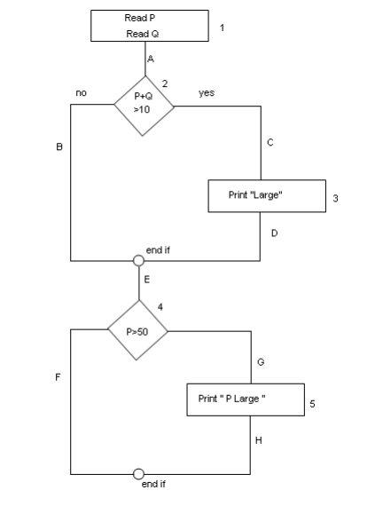
Example:
Read P
Read Q
IF P+Q > 100 THEN
Print “Large”
ENDIF
If P > 50 THEN
Print “P Large”
ENDIF
Consider the flow chart

Slide 19
Statement Coverage (SC):
To calculate Statement Coverage, find out the shortest number of paths following
which all the nodes will be covered. Here by traversing through path 1A-2C-3D-E-4G-5H all
the nodes are covered. So by traveling through only one path all the nodes 12345 are covered,
so the Statement coverage in this case is 1.

Slide 20
To calculate Branch Coverage, find out the minimum number of paths which will
ensure covering of all the edges. In this case there is no single path which will ensure coverage of all the edges at one go. By following paths 1A-2C-3D-E-4G-5H, maximum numbers of edges (A, C, D, E, G and H) are covered but edges B and F are left. To covers these edges we can follow 1A-2B-E-4F. By the combining the above two paths we can ensure of traveling
through all the paths. Hence Branch Coverage is 2. The aim is to cover all possible true/false
decisions.

Slide 21
Path Coverage (PC):
Path Coverage ensures covering of all the paths from start to end.
All possible paths are-
1A-2B-E-4F
1A-2B-E-4G-5H
1A-2C-3D-E-4G-5H
1A-2C-3D-E-4F
So path coverage is 4.
Thus for the above example SC=1, BC=2 and PC=4.

Slide 22
Integration Testing
Big-bang
Bottom-up
Top-down
Sandwich testing

Slide 23
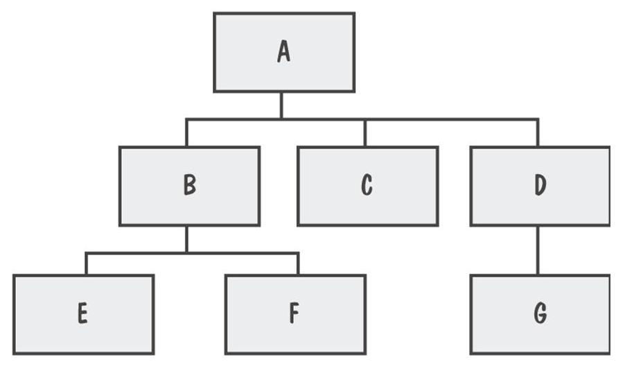
Integration Testing
System viewed as a hierarchy of components

Slide 24
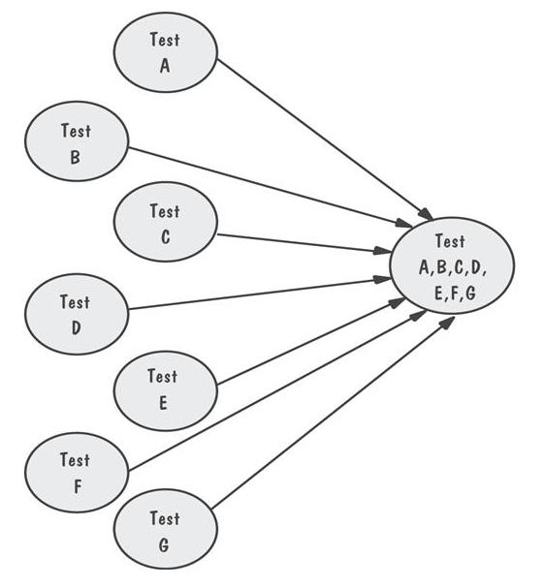
Integration Testing Bing-Bang Integration Example
All components integrated at once
Locating faults?

Slide 25
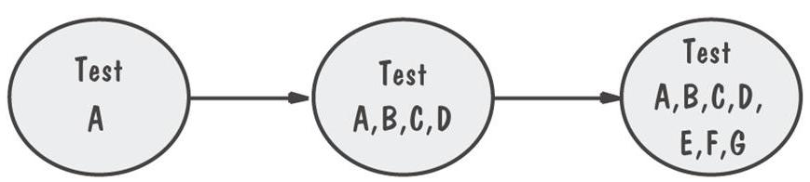
Integration Testing Top-Down Integration Example
Integrate from Top to bottom
Locating faults?

Slide 26
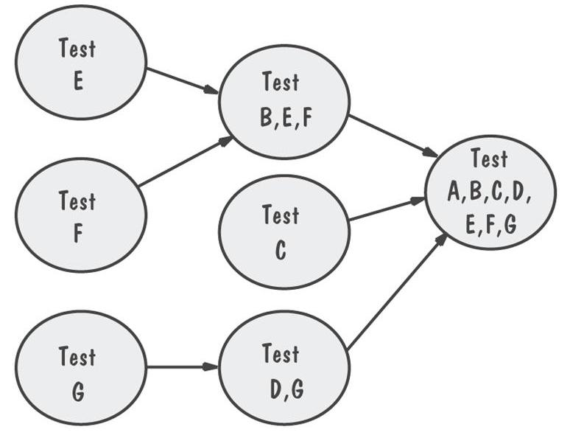
Integration Testing Bottom-Up Integration Example
Locating faults?

Slide 27
Integration Testing Sandwich Integration
Integrate both

Slide 28
System Testing
System is tested as a whole
Different types of testing considered during System Testing:
Assignment
Functional Testing (GUI) - Scalability
- Performance Testing - Sanity
- Usability - Smoke
- Load - Regression
- Volume - Compatibility
- Stress - Installation
- Security - Ad hoc

Slide 29
Steps to do System Testing
The following steps are important to perform System Testing:
Step 1: Create a System Test Plan
Step 2: Create Test Cases
Step 3: Carefully Build Data used as Input for System Testing
Step 3: If applicable create scripts to
- Build environment and
- to automate Execution of test cases
Step 4: Execute the test cases
Step 5: Fix the bugs if any and re test the code
Step 6: Repeat the test cycle as necessary

Slide 30
Acceptance Tests Purpose and Roles
Enable the customers and users to determine if the built system meets their needs and expectations
Written, conducted and evaluated by the customers

Slide 31
Acceptance Tests Types of Acceptance Tests
Pilot test: install on experimental basis
Alpha test: in-house test
Beta test: customer pilot

Slide 32
Result of Acceptance Tests
List of requirements that
are not satisfied
must be deleted
must be revised
must be added

Slide 33
Installation Testing
Before the testing
Configure the system
Attach proper number and kind of devices
Establish communication with other system
The testing
to verify that the system has been installed properly and works

Slide 34
Software Testing Tools
Automated Testing Tools
Selenium, QTP, SilkTest, WinRunner, LoadRunner, Jmeter
Testing Management Tools
TestManager, TestDirector
Bug Tracking/Configuration Management Tools
Bugzilla, Jitterbug, SilkRadar

Slide 35
When to Stop Testing
No time left
No money left
Statistical Criteria
Number of defects found per week becomes lower than a set threshold

Slide 36
Test Planning
Establish test objectives
Design and Write test cases
Test test cases
Execute tests
Evaluate test results

Slide 37
Test Planning Purpose of the Plan
Test plan explains
who does the testing
why the tests are performed
how tests are conducted
when the tests are scheduled

Slide 38
Test Planning Contents of the Plan
What the test objectives are
How the test will be run
What criteria will be used to determine when the testing is complete

Slide 39
Test Documentation
Test plan: describes system and plan for exercising all functions and characteristics
Test specification and evaluation: details each test and defines criteria for evaluating each feature
Test description: test data and procedures for each test
Test analysis report: results of each test

Slide 40
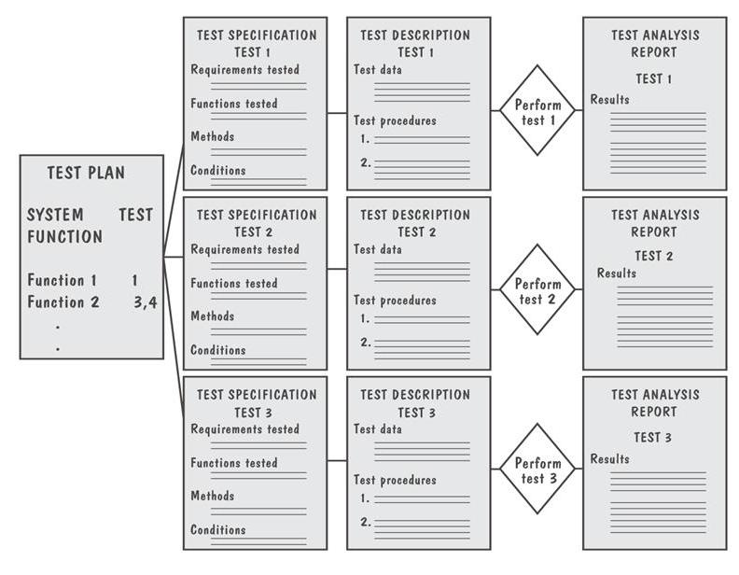
Test Documentation Documents Produced During Testing

Slide 41
Test Documentation Test Plan
The plan begins by stating its objectives, which should
guide the management of testing
guide the technical effort required during testing
establish test planning and scheduling
explain the nature and extent of each test
explain how the test will completely evaluate system function and performance
document test input, specific test procedures, and expected outcomes

Slide 42
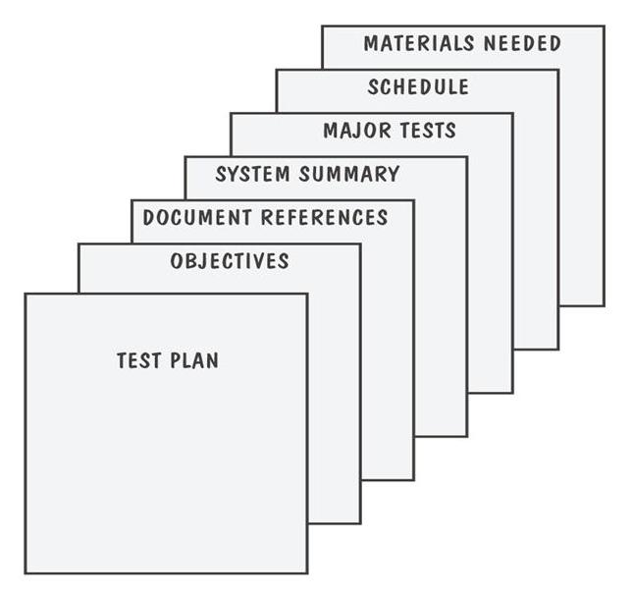
Test Documentation Parts of a Test Plan

Slide 43
Test Documentation Test Analysis Report
Documents the result of test
Provides information needed to duplicate the failure and to locate and fix the source of the problem
Provides information necessary to determine if the project is complete
Establish confidence in the system’s performance

Slide 44
Test Documentation Problem Report Forms
Location: Where did the problem occur?
Timing: When did it occur?
Symptom: What was observed?
End result: What were the consequences?
Mechanism: How did it occur?
Cause: Why did it occur?
Severity: How much was the user or business affected?
Cost: How much did it cost?

Slide 45
References
UCF Slides
Software Testing, A Craftsman’s Approach by Jorgensen
Software Testing Tools by Prasad
Software Engineering, Business Continuity, and Education. Kim, Adeli et al (Eds.)
https://www.guru99.com/cyclomatic-complexity.html

